Slide 1
Bayesian Networks
CS161
Prof. Guy Van den Broeck

Slide 2
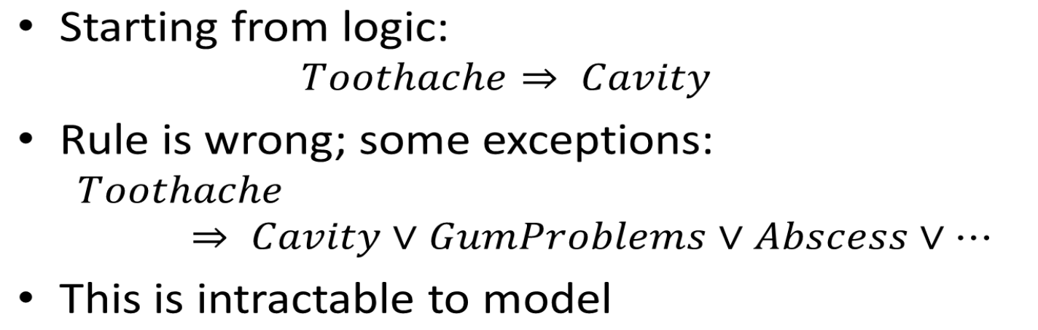
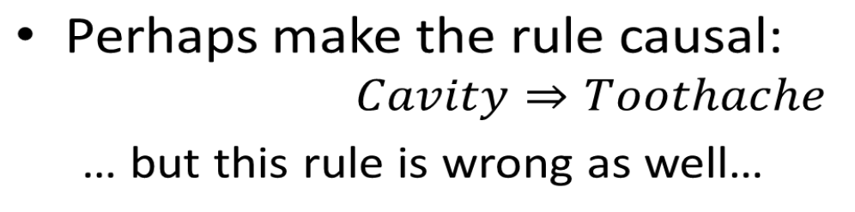
Motivation from Logic
because Laziness - Theoretical Ignorance - Practical Ignorence

Slide 3
Motivation from Logic
The monotonicity of logic is the problem… again
Either you model everything exhaustively
Intractable to model; we are too ignorant
Even if you could, you will never be able to act
Assume too much and get stuck when things don’t go as expected
Epistemological change: we no longer believe in a set of possible worlds (models), we believe in a probability for each world!

Slide 4
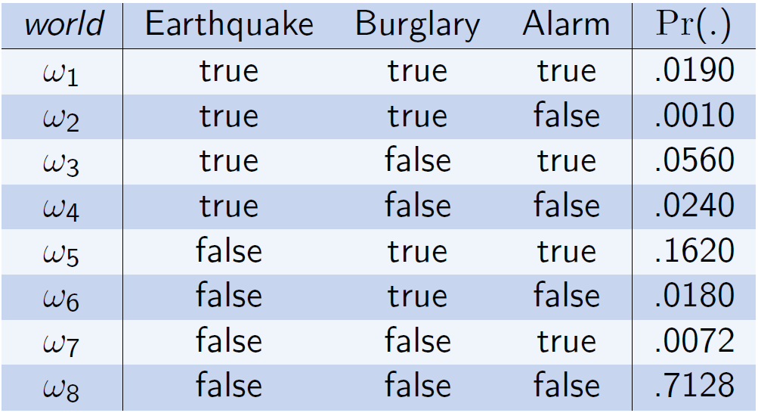
Possible Worlds
[Darwiche ‘08]

Slide 5
Logical Beliefs about the World
M(KB)
true
true
false
true
false
false
false
false
[Darwiche ‘08]

Slide 6
Prob. Beliefs about the World
[Darwiche ‘08]

Slide 7
World View
Propositional
Global properties that are true or false
Probabilistic
Belief is still a set of possible world
But now they have a degree of belief Pr(.)
Knowledge Base KB ≈ Pr
“Uncertainty is epistemological – pertaining to an agent’s beliefs of the world – rather than ontological – how the world is.” [Poole et al.]
We can have different beliefs about the same world
What’s the probability that the world ends tomorrow?

Slide 8
Decision-Making Motivation
Acting with partial (noisy) sensor information
Consider ever logically possible explanation
Example: drive to airport
No plan is guaranteed to achieve goal
Yet the agent must act
Decisions depend on
Relative importance of goals (utility)
The likelihood of achieving them (probability)
Maximum expected utility

Slide 9
Propositions are only Boolean?
Categorical variables
Weather=sunny, Weather=rainy, Weather=snowy
3 Boolean variables that are mutually exclusive
Sometimes called “indicator variables”
Can all be encoded in sentences…
Continuous variables
Temperature=73.514, Temperature=78.785, …
Infinitely many Boolean variables (and worlds).
In logic, see SAT Modulo Theories (SMT)
Special accommodations for continuous variables in statistics; we will mostly stick to the discrete world.

Slide 10
Sentences or “Events”
Belief is a probability for every world: Pr(ω)
What is the probability of a sentence (or event) α?
Need to axiomatize probability [Kolmogorov]
Probabilities are non-negative: 0 ≤ Pr(ω)
Probability of true event is one: Pr(true) = 1
If α and β are mutually exclusive, then Pr(α v β) = Pr(α) + Pr(β)

Slide 11
Sentences or “Events”
Everything follows from this axiomatization
What is the probability of a sentence (or event) α?
Sentence α is equivalent to the disjunction of its models: α ≡ ω₁ v ω₃v ω₇v ω₄₂v ⋯
Each ω_{i} represents a single world: X₁∧¬X₂∧¬X₃∧⋯
Each ω_{i}, ω_{j} for i≠j are mutually exclusive
Pr(α) = Pr(ω₁) + Pr(ω₃) + Pr(ω₇) + Pr(ω₄₂) + ⋯

Slide 12
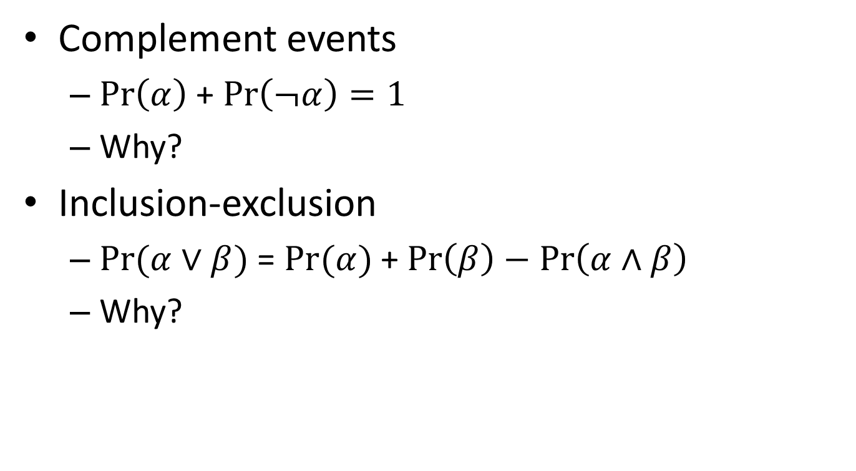
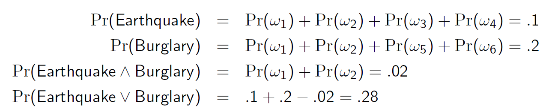
Properties of Probability
[Darwiche ‘08]

Slide 13
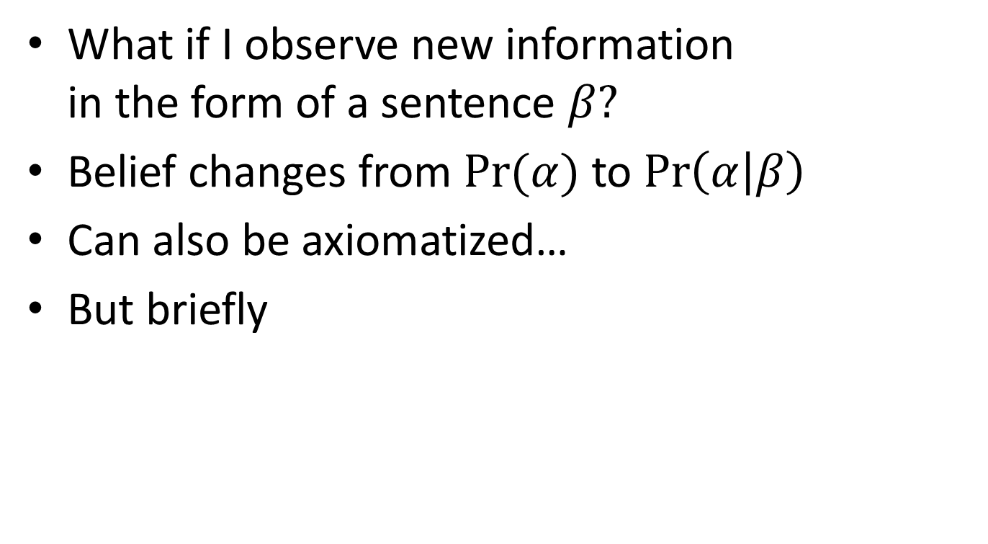
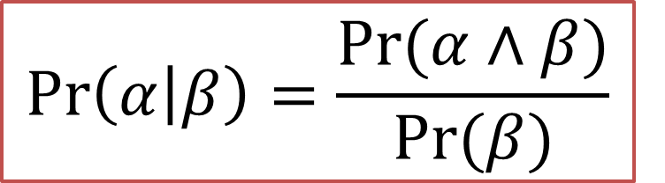
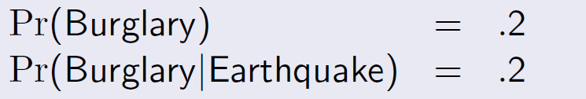
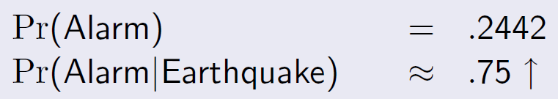
Conditional Probability
[Darwiche ‘08]

Slide 14
Monotonicity of Belief?
Recall: monotonicity of logic
Is it possible to observe something new and undo prior beliefs?
Example:
Alarm and not Earthquake: .1620+.0072=0.1692
Not Earthquake: .9
Alarm given not Earthquake: .188 (NON-MONOTONIC!)
[Darwiche ‘08]

Slide 15
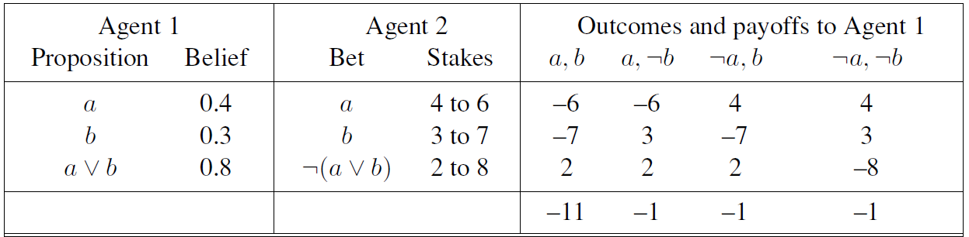
Betting Semantics
I believe P(a) = 0.4 so I get $6 for `a’ and pay $4 for `not a’.
I believe P(a) = 0.4, P(b) = 0.3, P(a ^ b) = 0.0, P(a v b) = 0.8

Slide 16

Product Rule and Chain Rule

Slide 17
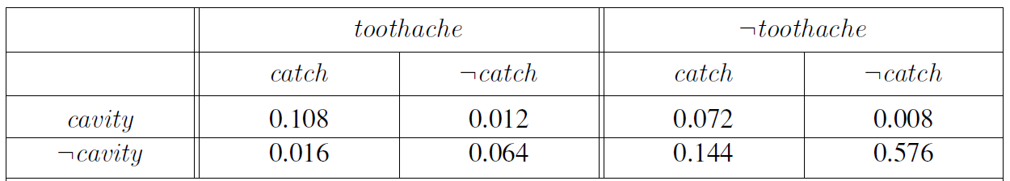
Computing Probabilities: Example

Slide 18
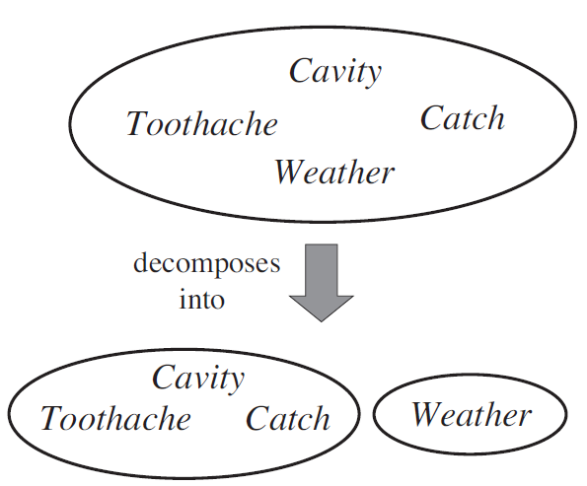
Independence

Slide 19
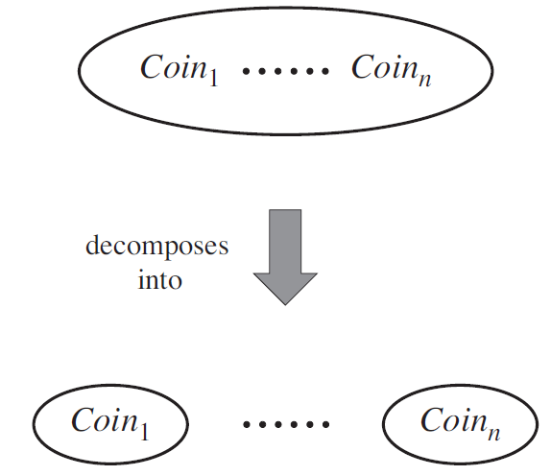
Independence

Slide 20
Bayes Rule

Slide 21
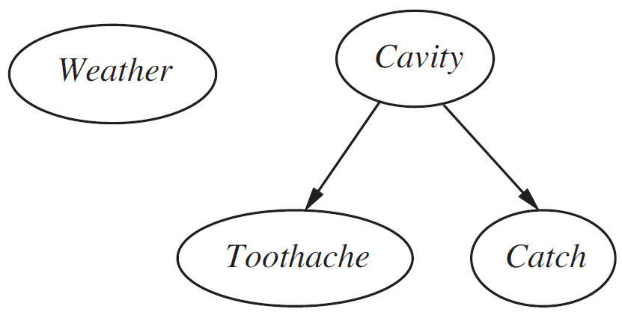
Conditional Independence

Slide 22
Naïve Bayes Assumption
This is how spam filters work!

Slide 23
Bayesian Networks

Slide 24
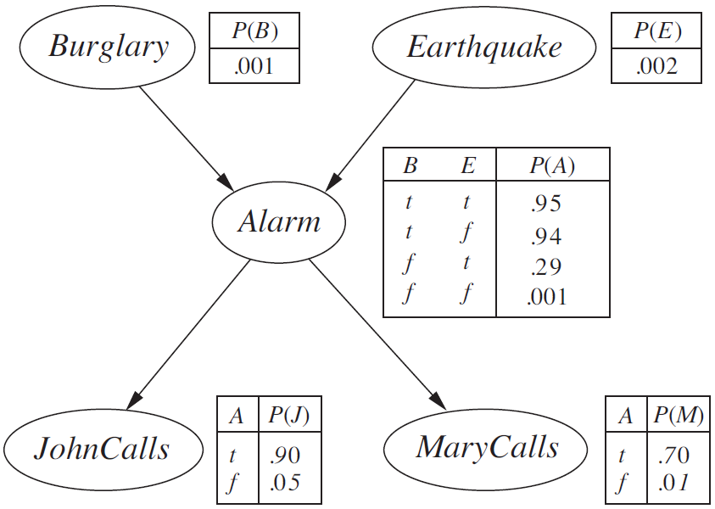

Slide 25
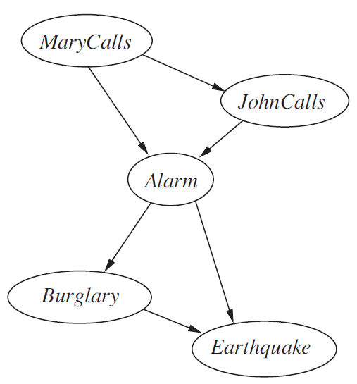
Conditional Independence and Order

Slide 26
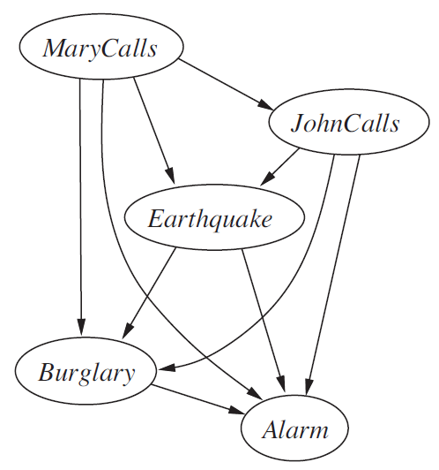
Conditional Independence and Order

Slide 27
Topological Semantics
What knowledge is encoded in Bayesian network structure?

Slide 28
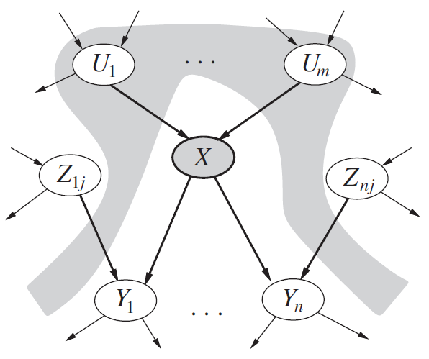
Markovian Assumptions

Slide 29
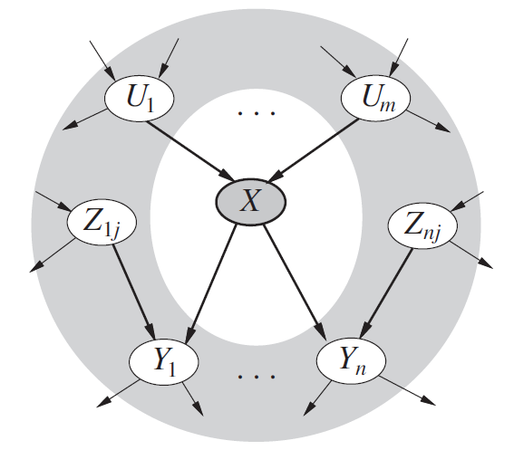
Markov Blanket

Slide 30
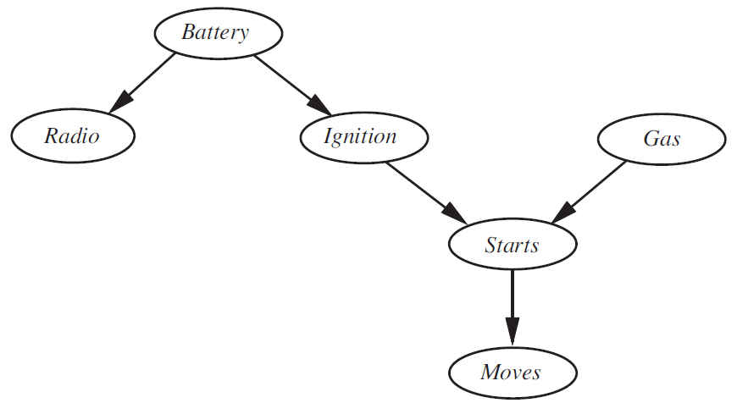
Example Network

Slide 31
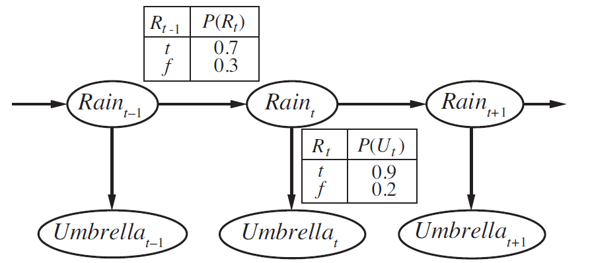
Markov Chains and Hidden Markov Models

Slide 32
Inference by Enumeration

Slide 33
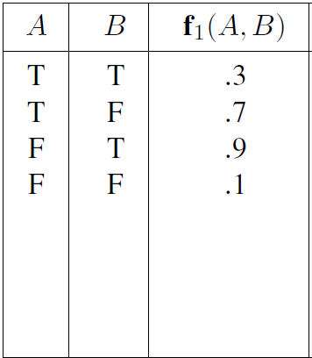
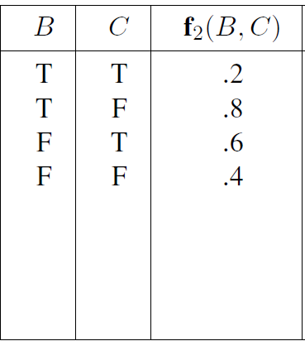
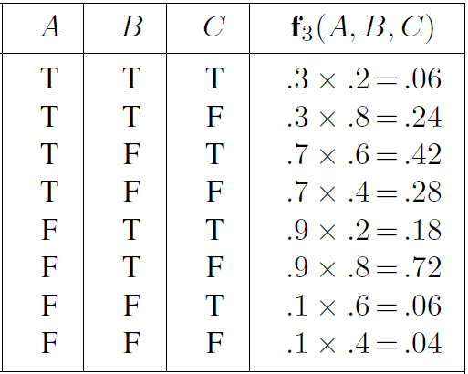
Factor Multiplication
X
=

Slide 34
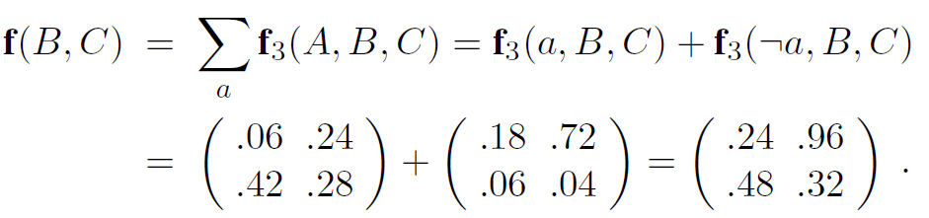
Summing out Variable from Factor

Slide 35
Variable Elimination

